Slide 1
KRAS G12C Inhibitor Combinations
Gregory J. Riely
Memorial Sloan Kettering Cancer Center

Slide 2
Disclosures
Institutional research funding:
Mirati,
Merck,
Novartis,
Pfizer,
Takeda,
Roche

Slide 3
Why combinations?

Slide 4
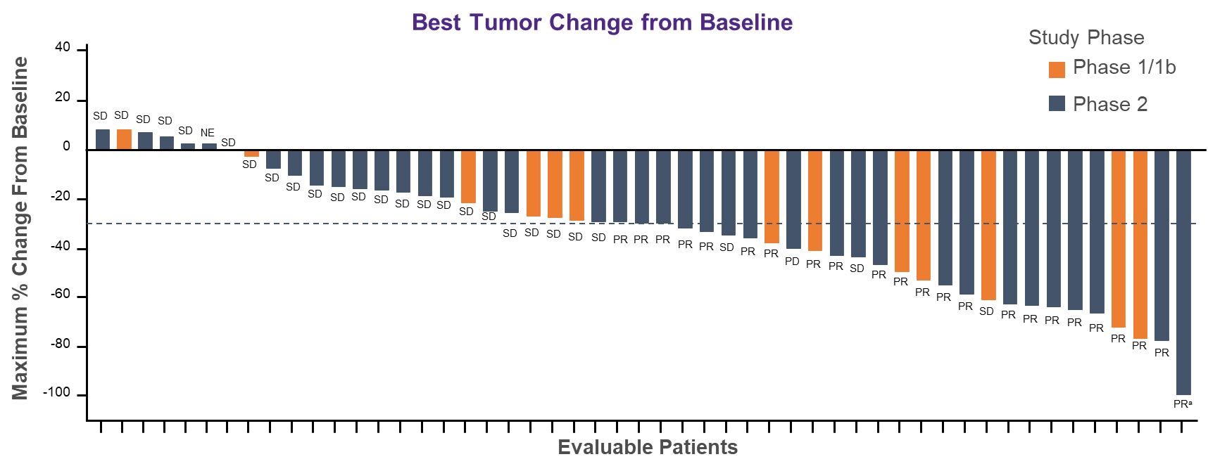
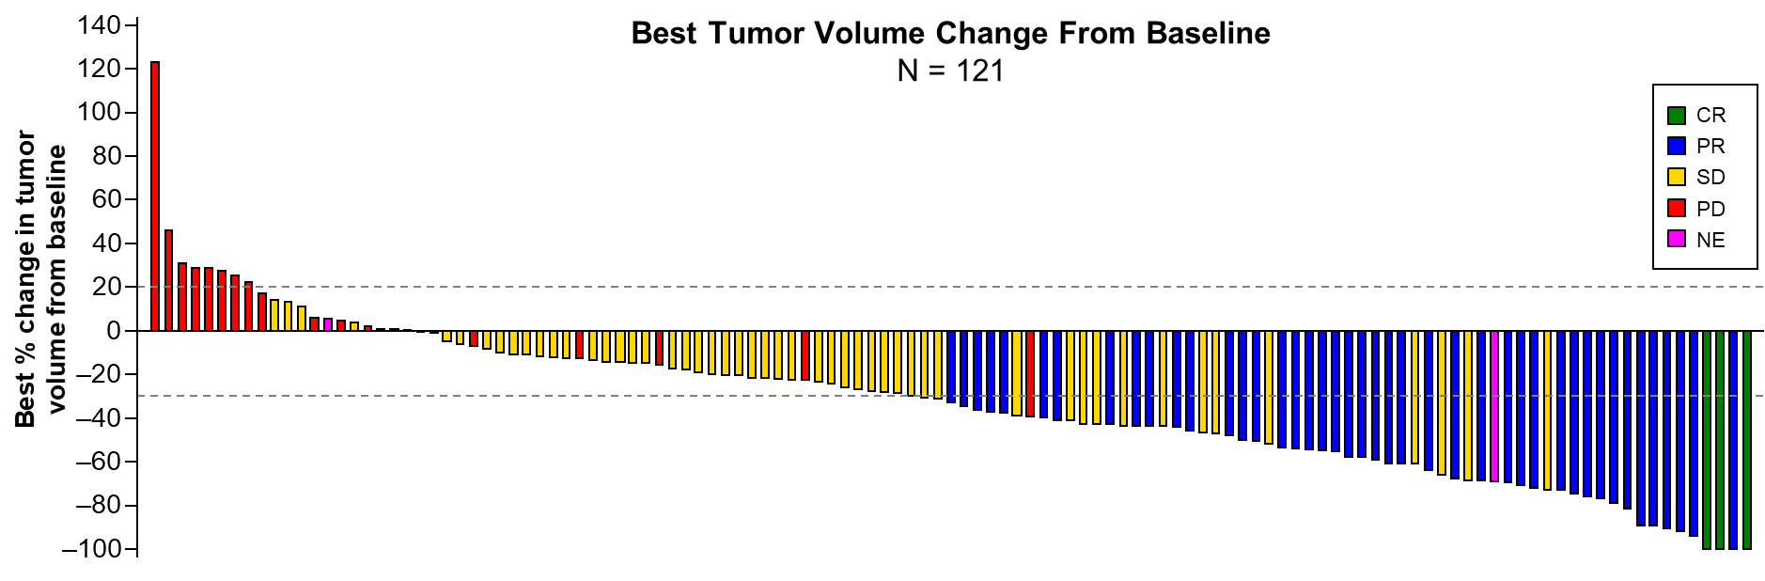
Single-agent G12C inhibitors
adagrasib 600 bid
sotorasib 960 mg daily
N=51
Response Rate 45%
Disease Control Rate 96%
N=121
Response Rate 37%
Disease Control Rate 81%
Janne et al, ENA 2020
Li et al, WCLC 2020
Presented at Santa Monica TTLC 2021 by Gregory Riely, MD, PhD

Slide 5
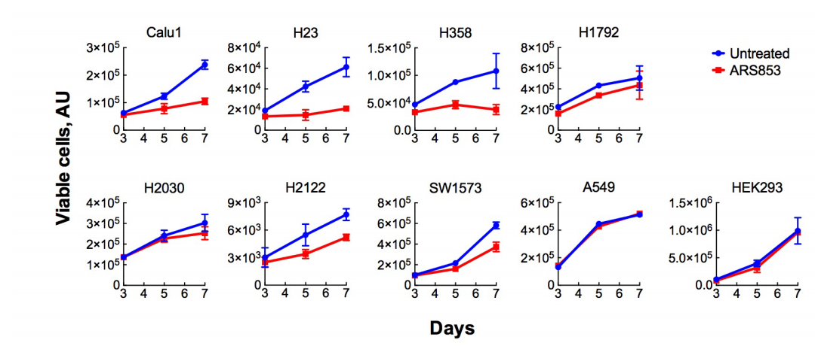
KRAS G12C Inhibitors Can Inhibits Some But Not All KRASG12C Cell Lines (ARS853)
KRAS
G12S
KRAS
WT
Presented at Santa Monica TTLC 2021 by Gregory Riely, MD, PhD
Lito et al, Science 2016

Slide 6
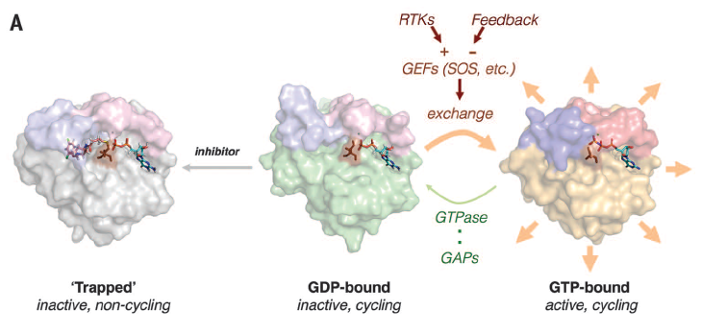
Dogma: Mutant KRAS lacks GTPase activity, leaving mutant KRAS constitutively active
Presented at Santa Monica TTLC 2021 by Gregory Riely, MD, PhD
Modified from Lito et al, Science 2016

Slide 7
Dogma: Mutant KRAS lacks GTPase activity, leaving mutant KRAS constitutively active
But, these KRAS G12C inhibitors bind to the GDP-bound, inactive state, and still inhibit mutant KRAS
Presented at Santa Monica TTLC 2021 by Gregory Riely, MD, PhD
Modified from Lito et al, Science 2016

Slide 8
KRAS G12C inhibitors bind inactive, GDP-bound RAS G12C and trap it in an inactive state
Presented at Santa Monica TTLC 2021 by Gregory Riely, MD, PhD
Lito et al, Science 2016

Slide 9
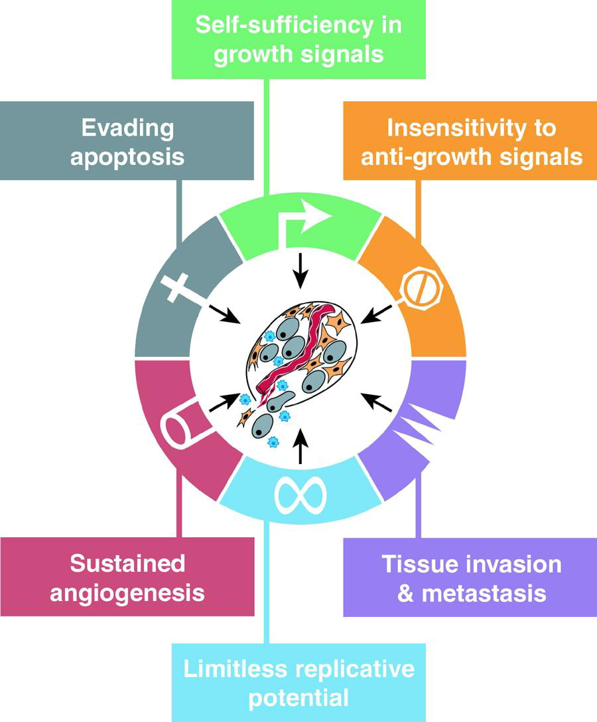
With which drugs should you combine G12Ci?
Drugs whose targets are important to KRAS signaling
Drugs that affect other pathways important in tumor biology
Drugs that are otherwise a key part of treatment of NSCLC
Hanahan and Weinberg 2000
Presented at Santa Monica TTLC 2021 by Gregory Riely, MD, PhD

Slide 10
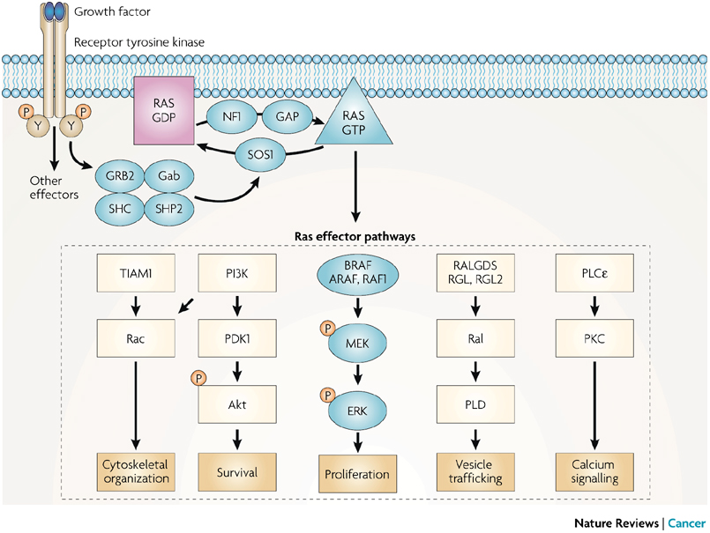
Schubbert Nature Reviews Cancer 7:295-308
Presented at Santa Monica TTLC 2021 by Gregory Riely, MD, PhD

Slide 11
Schubbert Nature Reviews Cancer 7:295-308
Presented at Santa Monica TTLC 2021 by Gregory Riely, MD, PhD

Slide 12
KRAS G12C Inhibitor Can Inhibits Some But Not All KRASG12C Cell Lines (ARS853)
KRAS
G12S
KRAS
WT
Presented at Santa Monica TTLC 2021 by Gregory Riely, MD, PhD
Lito et al, Science 2016

Slide 13
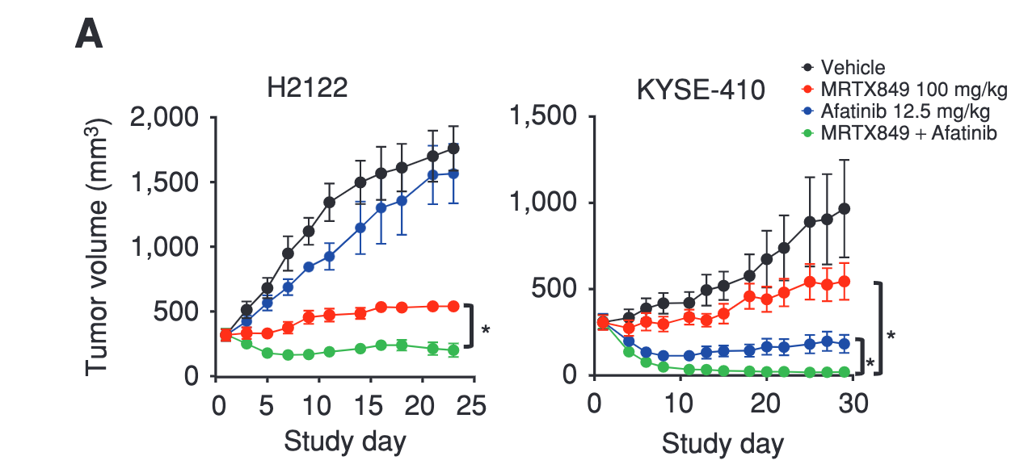
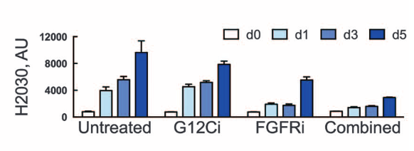
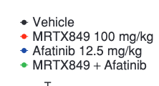
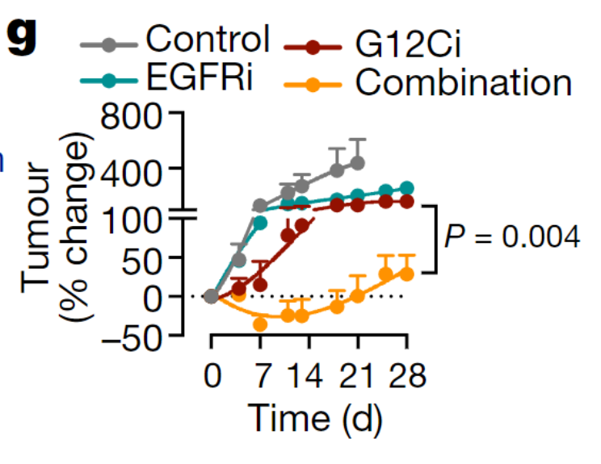
Adding RTK Inhibitors May Potentiate Effects of Direct RAS Inhibitors
Lito et al, Science 2016
Hallin et al, Can Discovery 2020
Xue et al, Nature 2020
Presented at Santa Monica TTLC 2021 by Gregory Riely, MD, PhD
Mice bearing xenografts of H2122 cells were treated as shown, to determine the effect on tumour growth. Mean + s.e.m, n = 4 mice.

Slide 14
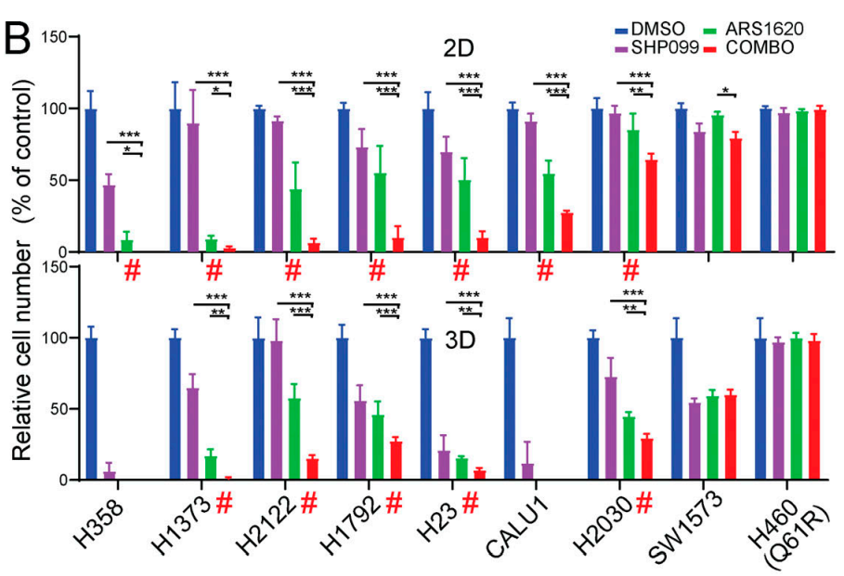
Shp2 inhibitors can synergize with KRAS G12Ci
Presented at Santa Monica TTLC 2021 by Gregory Riely, MD, PhD
Fedele et al, JEM 2020

Slide 15
Schubbert Nature Reviews Cancer 7:295-308
Presented at Santa Monica TTLC 2021 by Gregory Riely, MD, PhD

Slide 16
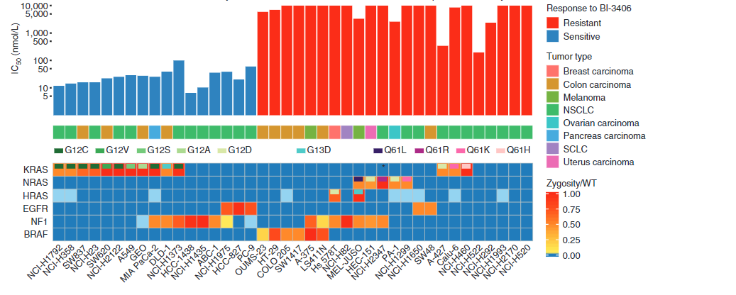
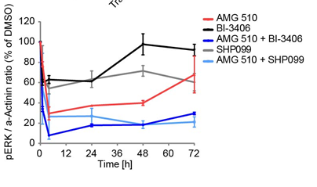
SOS1 inhibitor can inhibit KRAS mutant cell lines and combining with G12Ci leads to better efficacy
NCI-H358
Majority of sensitive lines are NSCLC. Among those, KRAS mut common.
Hoffmann et al, Cancer Discovery 2021
Presented at Santa Monica TTLC 2021 by Gregory Riely, MD, PhD

Slide 17
Some of the G12C inhibitor combinations being studied
 | PD-1/PD-L1 | Shp2 | EGFR | MEK | VEGF | Chemo | SOS1
sotorasib | X | X | X | X |  | X
adagrasib | X | X | X |  |  |  | X
GDC-6036 | X |  | X |  | X
JDQ443 | X | X
Source: clinicaltrials.gov, accessed 2/2/21; NCT03785249, NCT04185883, NCT04449874, NCT04699188
Presented at Santa Monica TTLC 2021 by Gregory Riely, MD, PhD

Slide 18
Conclusions
Cell line and xenograft data suggest many rational combinations with KRAS G12C inhibitors.
Such combinations, and more, are currently being studied.
We look forward to toxicity and efficacy data (both response rate and duration of response).
Presented at Santa Monica TTLC 2021 by Gregory Riely, MD, PhD

Slide 19
Shp2
Phase 1/2 Study in Patients With Cancer Having a KRAS G12C Mutation KRYSTAL 2 - NCT04330664
AMG 510 (pINN) Sotorasib Activity in Subjects With Advanced Solid Tumors With KRAS p.G12C Mutation (CodeBreak 101) - NCT04185883
Study of JDQ443 in Patients With Advanced Solid Tumors Harboring the KRAS G12C Mutation - NCT04699188
Presented at Santa Monica TTLC 2021 by Gregory Riely, MD, PhD

Slide 20
Anti-PD-1/PD-L1
Phase 1/2 Study of MRTX849 in Patients With Cancer Having a KRAS G12C Mutation KRYSTAL-1 - NCT03785249
AMG 510 (pINN) Sotorasib Activity in Subjects With Advanced Solid Tumors With KRAS p.G12C Mutation (CodeBreak 101) - NCT04185883
A Study to Evaluate the Safety, Pharmacokinetics, and Activity of GDC-6036 Alone or in Combination in Participants With Advanced or Metastatic Solid Tumors With a KRAS G12C Mutation - NCT04449874
Study of JDQ443 in Patients With Advanced Solid Tumors Harboring the KRAS G12C Mutation - NCT04699188
Presented at Santa Monica TTLC 2021 by Gregory Riely, MD, PhD

Slide 21
EGFR TKI
Phase 1/2 Study of MRTX849 in Patients With Cancer Having a KRAS G12C Mutation KRYSTAL-1 - NCT03785249
AMG 510 (pINN) Sotorasib Activity in Subjects With Advanced Solid Tumors With KRAS p.G12C Mutation (CodeBreak 101) - NCT04185883
A Study to Evaluate the Safety, Pharmacokinetics, and Activity of GDC-6036 Alone or in Combination in Participants With Advanced or Metastatic Solid Tumors With a KRAS G12C Mutation - NCT04449874
Presented at Santa Monica TTLC 2021 by Gregory Riely, MD, PhD

Slide 22
Chemotherapy
AMG 510 (pINN) Sotorasib Activity in Subjects With Advanced Solid Tumors With KRAS p.G12C Mutation (CodeBreak 101) - NCT04185883
Presented at Santa Monica TTLC 2021 by Gregory Riely, MD, PhD

Slide 23
MEK inhibitor
AMG 510 (pINN) Sotorasib Activity in Subjects With Advanced Solid Tumors With KRAS p.G12C Mutation (CodeBreak 101) - NCT04185883
Presented at Santa Monica TTLC 2021 by Gregory Riely, MD, PhD

Slide 24
Anti-VEGF
A Study to Evaluate the Safety, Pharmacokinetics, and Activity of GDC-6036 Alone or in Combination in Participants With Advanced or Metastatic Solid Tumors With a KRAS G12C Mutation - NCT04449874
Presented at Santa Monica TTLC 2021 by Gregory Riely, MD, PhD

Slide 25
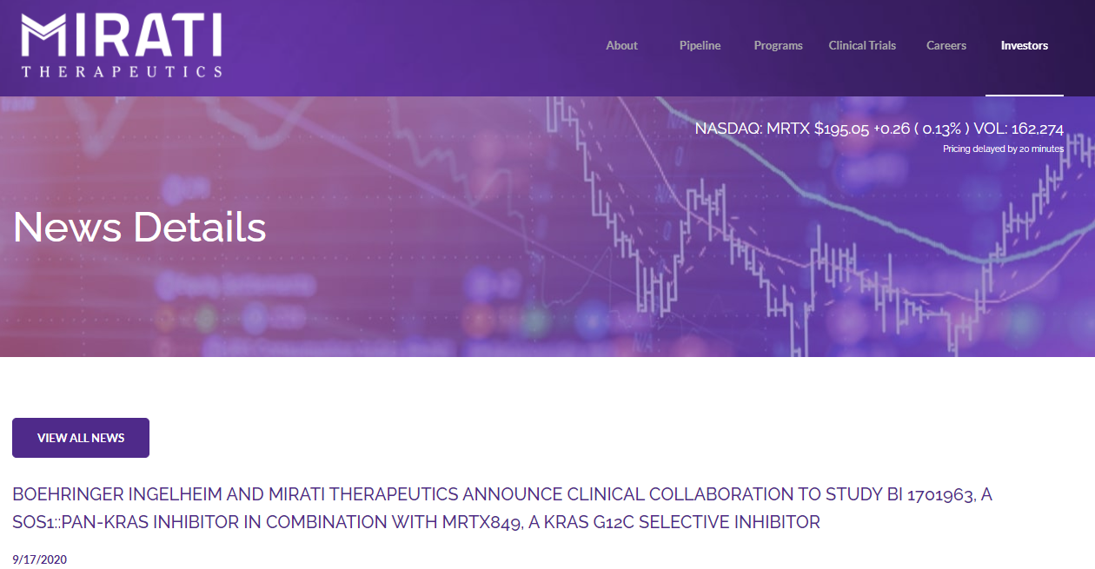
SOS Inhibitor
Presented at Santa Monica TTLC 2021 by Gregory Riely, MD, PhD

Slide 26
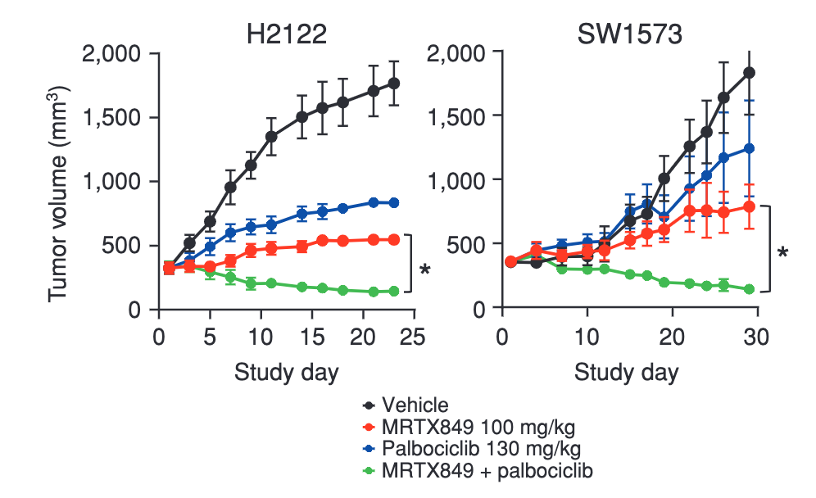
Addition of CDK4/6 inhibitors can potentiate activity of G12C inhibitors
Hallin et al, Can Discovery 2020
Presented at Santa Monica TTLC 2021 by Gregory Riely, MD, PhD

Slide 27
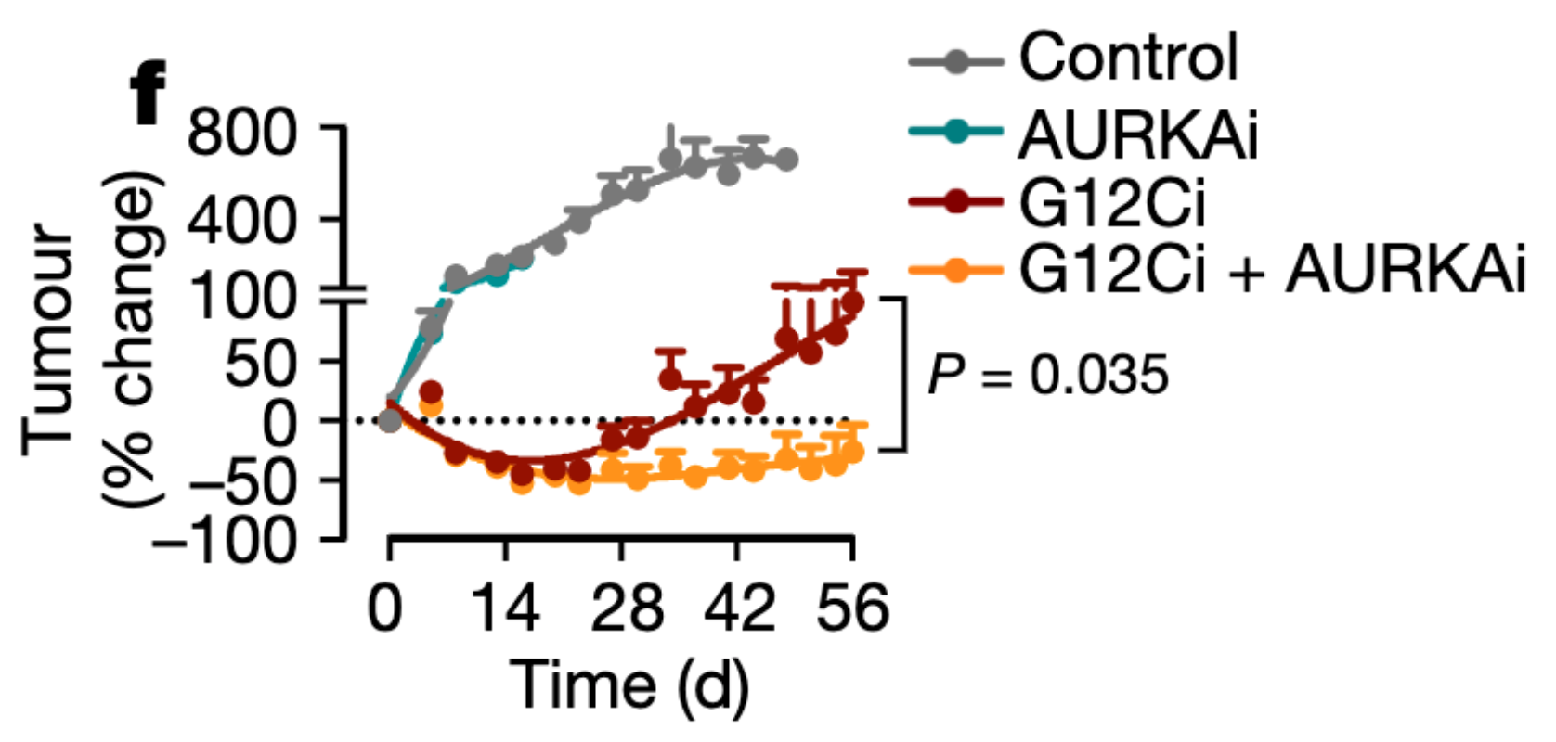
Aurora Kinase inhibitors can synergize with G12Ci
(alisertib)
Xue et al, Nature 2020
Presented at Santa Monica TTLC 2021 by Gregory Riely, MD, PhD

